Slide 1

Artificial Intelligence Programming Practice
Lecturer ： Rao Yunbo
University of Electronic Science and Technology of China ·
School of Information and Software Engineering
University of Electronic Science and Technology of China,
Chengdu, China , May 14, 2024

Slide 2
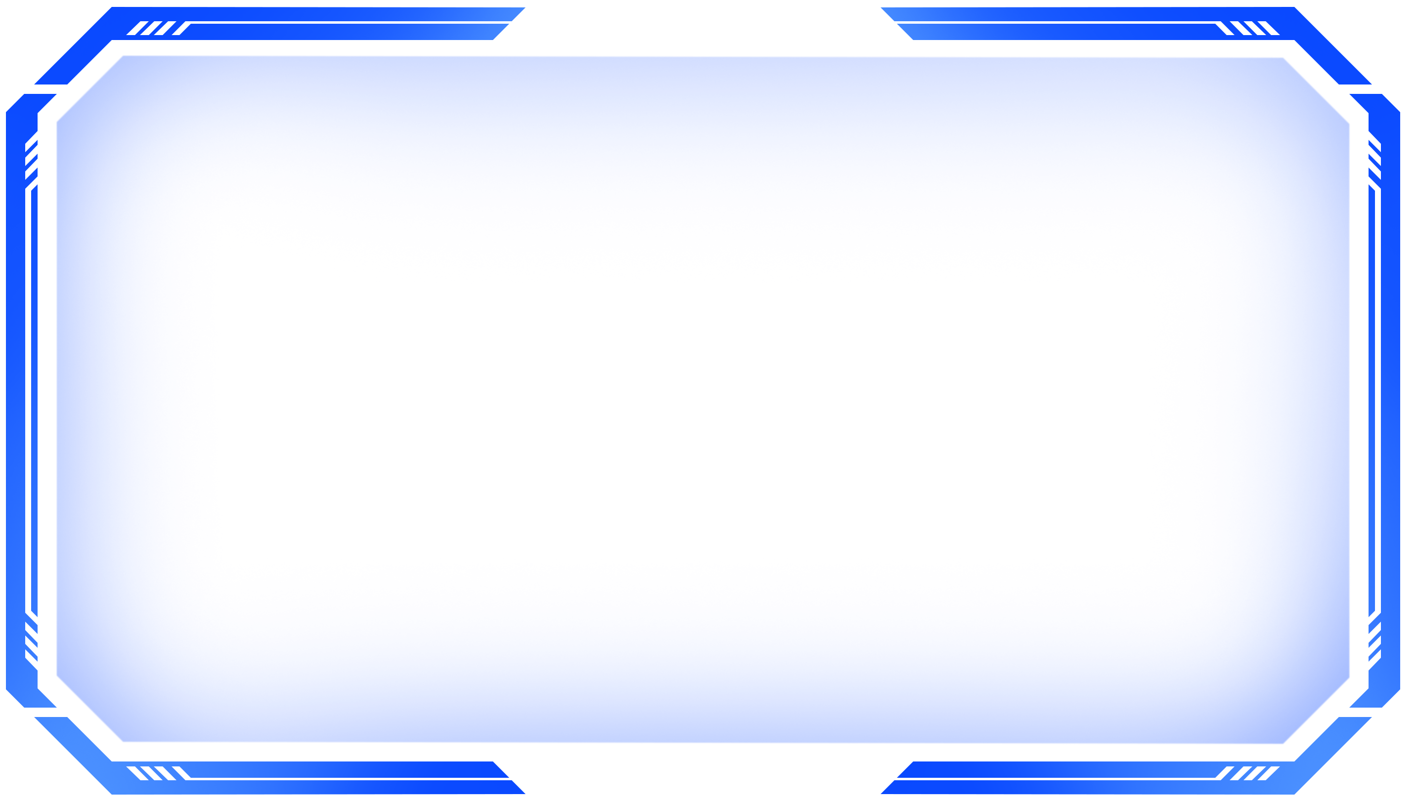
CNN concept
Content
01
Origin of Convolutional Neural Networks
02
Overview of Convolutional Neural Network Architecture
03
Fundamentals of Convolutional Neural Networks

Slide 3


CNN concept
Origin of Convolutional Neural Networks

Slide 4
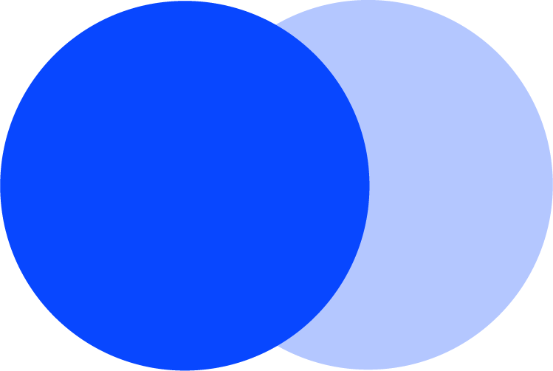
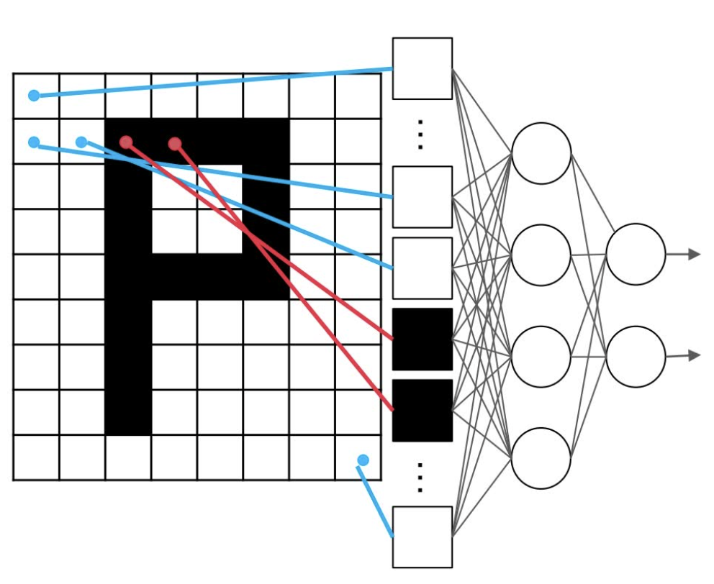
CNN concept
Origin of Convolutional Neural Networks
Disadvantages of Fully Connected Neural Networks
In the image classification task, first we need to convert the two-dimensional image into one-dimensional vectors sequentially fed into the neural network.
[ [ 0, 0, 0, 0, … , 0 ],
[ 0, 0, 1, 1, … , 0 ],
……
[ 0, 0, 0, 0, … , 0 ] ]
0 0
1
0
…
…
2-dimensional vector
1-dimensional vector

Slide 5
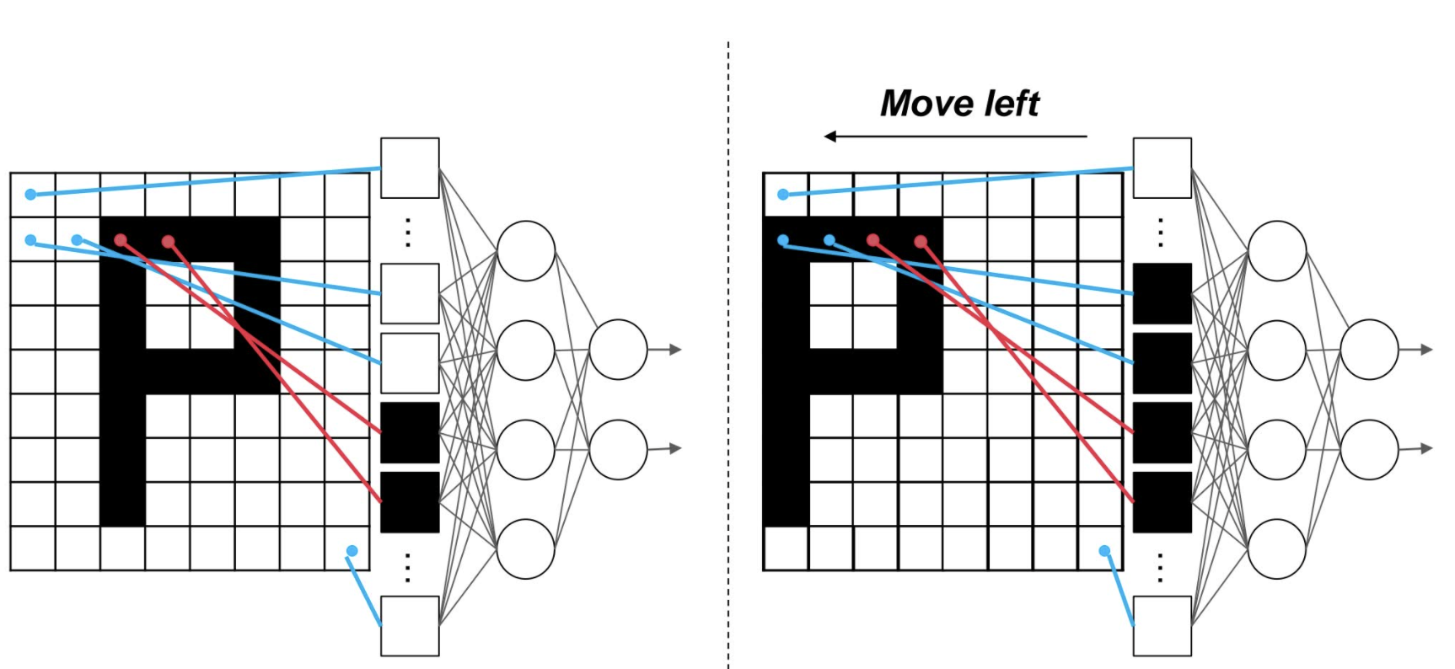

CNN concept
Origin of Convolutional Neural Networks
Disadvantages of Fully Connected Neural Networks
After the network is trained on this image, each neuron updates its parameters. But the problem arises when the “P” moves two spaces to the left ......

Slide 6
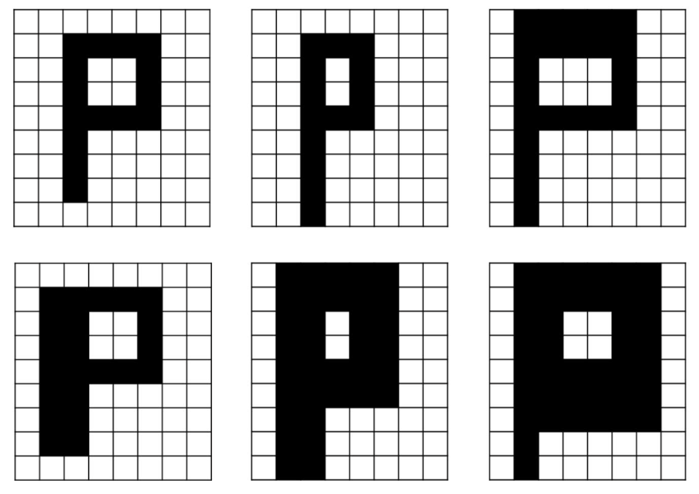
CNN concept
Origin of Convolutional Neural Networks
Disadvantages of Fully Connected Neural Networks
1. Unable to capture the spatial features of a 2D image, very sensitive to changes in position, size, and angle of the image, and prone to overfitting.

Slide 7
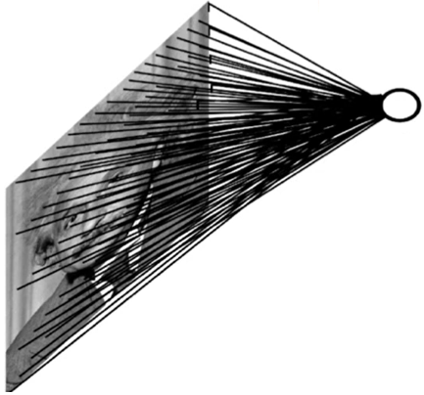
CNN concept
Origin of Convolutional Neural Networks
Disadvantages of Fully Connected Neural Networks
2. Parameter Explosion
Image size 9 * 8
The fully connected parameter is
9 * 8 * 4 * 2 = 576
Image size 1000 * 1000
The fully connected parameter is
1000 * 1000 * 4 * 2 = 8 * 10^6

Slide 8
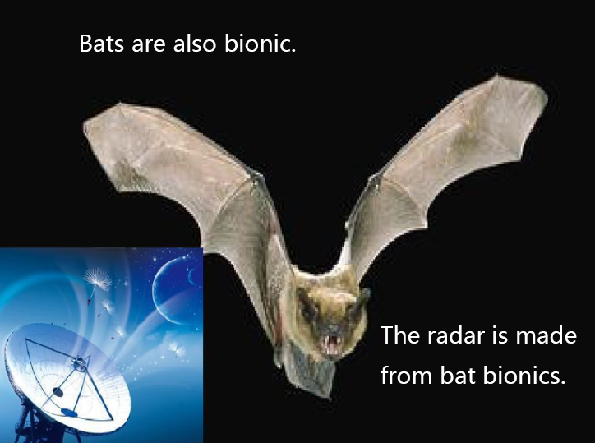
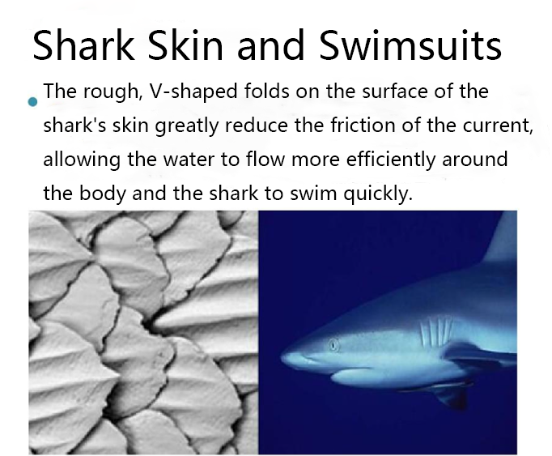
CNN concept
Origin of Convolutional Neural Networks
The origin of the idea of convolutional neural networks - Bionics

Slide 9
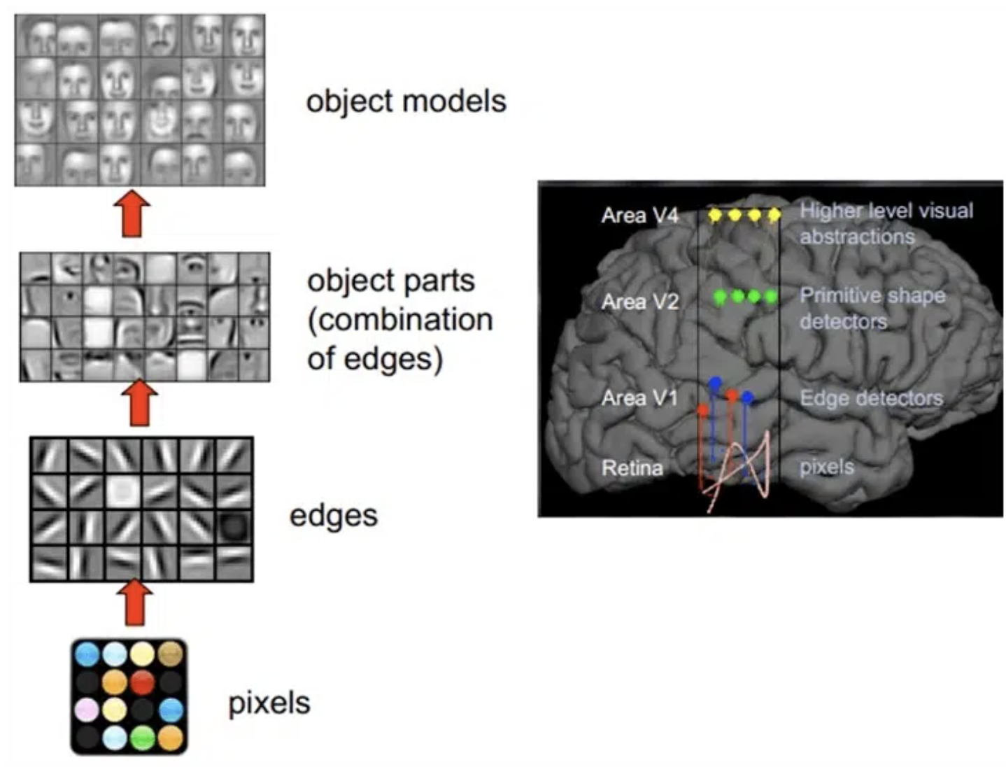
CNN concept
Origin of Convolutional Neural Networks
The human brain's process of analyzing images
integration analysis
combine to form outlines and detailed features
extraction of edge and directional features
pixel point

Slide 10
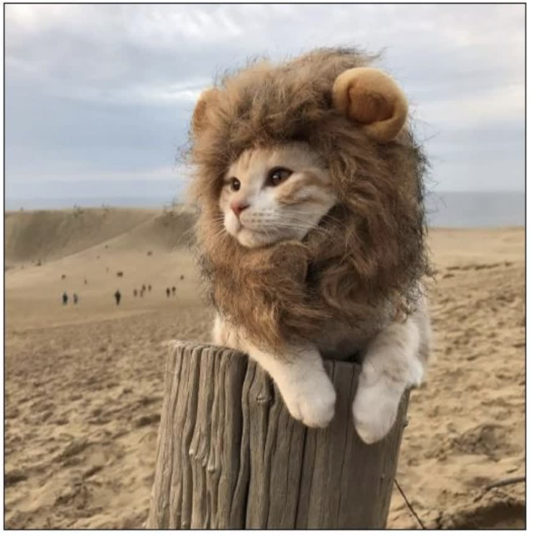
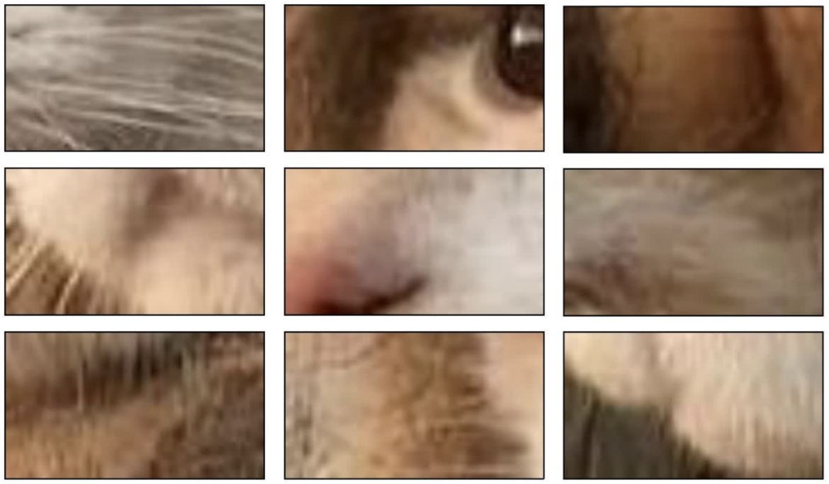
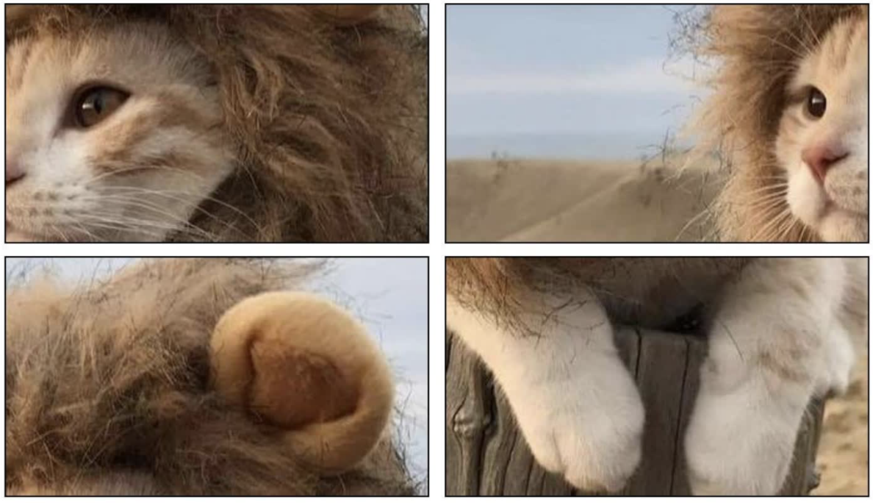
CNN concept
Origin of Convolutional Neural Networks
Assumption: Can a neural network be designed to achieve spatial feature extraction and integration analysis?
Spatial feature extraction
Integration Analysis
A cat disguised as a lion!
Image to be analyzed
X neural network

Slide 11
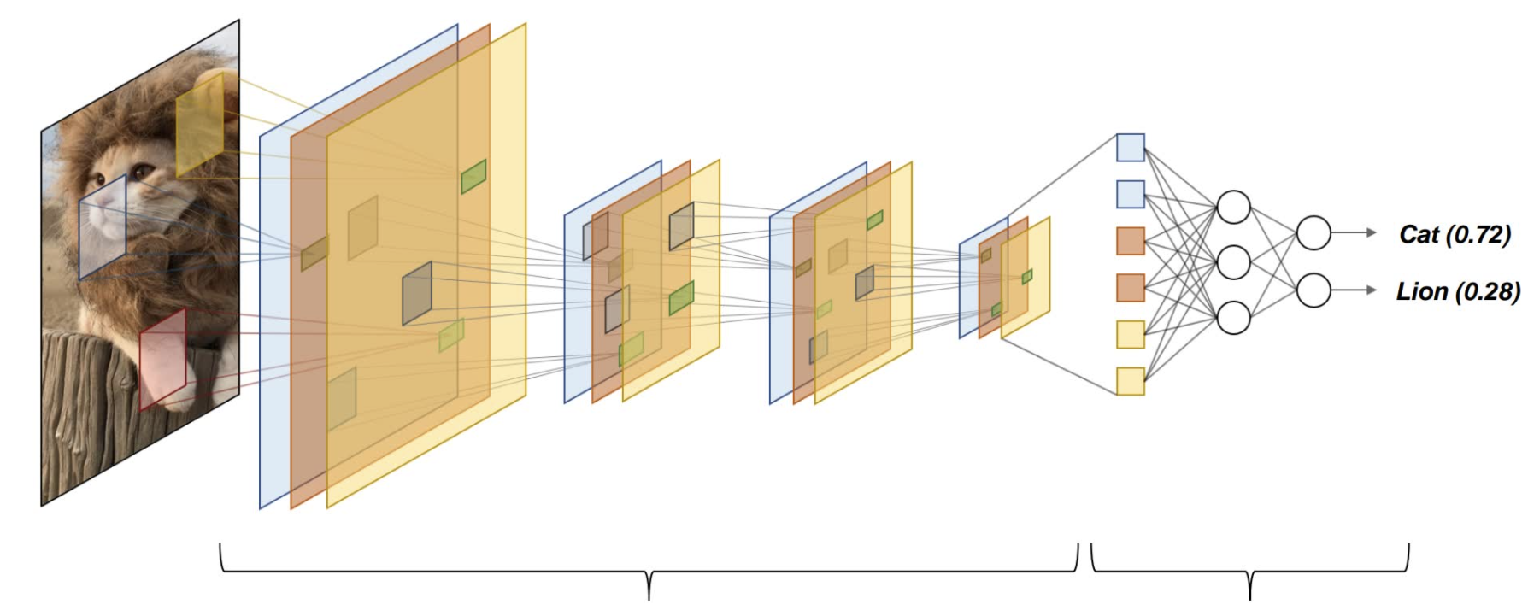
CNN concept
Definition of Convolutional Neural Networks
Convolutional Neural Networks (CNN) is a typical deep learning model, which imitates the visual perception mechanism of living creatures, so that it has the function of spatial feature extraction and integration analysis, and is mainly used in the field of computer vision.
Spatial feature extraction
Integration analysis

Slide 12

CNN concept
Overview of Convolutional Neural Network Architecture

Slide 13
CNN concept
Convolutional Neural Network Architecture
Spatial feature extraction
Integration Analysis
Convolutional layer
Fully connected layer
Input layer
+
Pooling layer

Slide 14
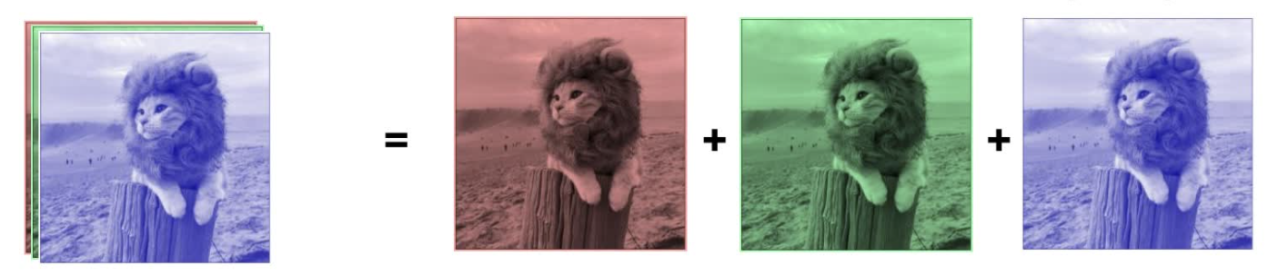
CNN concept
Convolutional Neural Network Architecture
Convolutional layer
Pooling layer
Fully connected layer
Input layer
RGB image size 32 x 32
Red Chanel
Green Chanel
Blue Chanel
[ 32 x 32 x 3 ]
[ 32 x 32 ]
[ 32 x 32 ]
[ 32 x 32 ]

Slide 15
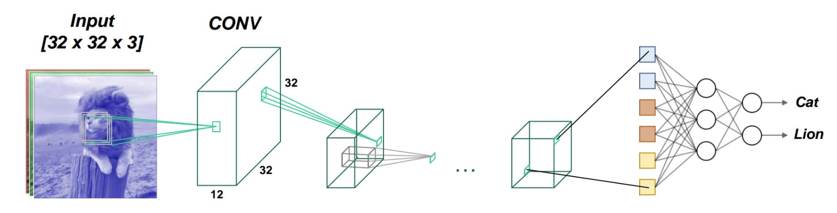
CNN concept
Convolutional Neural Network Architecture
Convolutional layer
Pooling layer
Fully connected layer
Input layer
Convolutional layers extract spatial features of each region in an image through special computational methods.
Input
Convolutional layer
[ 32 x 32 x 3 ]

Slide 16
CNN concept
Convolutional Neural Network Architecture
Convolutional layer
Pooling layer
Fully connected layer
Input layer
The pooling layer compresses the size of the image by downsampling, reducing the amount of parameter computation of the neural network.
Input
Convolutional layer
Pooling layer

Slide 17

CNN concept
Convolutional Neural Network Architecture
Convolutional layer
Pooling layer
Fully connected layer
Input layer
The pooling layer compresses the size of the image by downsampling, reducing the amount of parameter computation of the neural network.
Feature invariant
downsampling
Feature dimension reduction

Slide 18
CNN concept
Convolutional Neural Network Architecture
Convolutional layer
Pooling layer
Fully connected layer
Input layer
Before the fully connected layer, the multidimensional vector needs to be flattened into a one-dimensional vector.
Input
Convolutional layer
Pooling layer
Fatten
Fully connected layer

Slide 19
CNN concept
Convolutional Neural Network Architecture
Convolutional layer
Pooling layer
Fully connected layer
Input layer
The fully connected layer integrates and analyzes the extracted spatial features, and finally outputs the category to which the image belongs.
Input
Convolutional layer
Pooling layer
Fatten
Fully connected layer

Slide 20
CNN concept
Summary of CNN structure
Convolutional layer
Pooling layer
Fully connected layer
Input layer
Input
Convolutional layer
Pooling layer
Fatten
Fully connected layer

Slide 21

CNN concept
Fundamentals of Convolutional Neural Networks

Slide 22
CNN concept
The Theory of Convolutional Layer
Convolutional layer
Pooling layer
Fully connected layer
Input layer
Convolutional layers extract spatial features of each region in an image through special computational methods.
Input
Convolutional layer
[ 32 x 32 x 3 ]

Slide 23
CNN concept
The Theory of Convolutional Layer
Input image
Convolution kernel
Feature map
0 | 0 | 0 | 0 | 0 | 0 | 0
0 | 1 | 0 | 0 | 0 | 1 | 0
0 | 0 | 1 | 0 | 1 | 0 | 0
0 | 0 | 0 | 1 | 0 | 0 | 0
0 | 0 | 1 | 0 | 1 | 0 | 0
0 | 1 | 0 | 0 | 0 | 1 | 0
0 | 0 | 0 | 0 | 0 | 0 | 0
1 | 0 | 0
0 | 1 | 0
0 | 0 | 1
*
=
Convolution operation （ dot product ）

Slide 24
CNN concept
The Theory of Convolutional Layer
Input image
Convolution kernel
Feature map
0 | 0 | 0 | 0 | 0 | 0 | 0
0 | 1 | 0 | 0 | 0 | 1 | 0
0 | 0 | 1 | 0 | 1 | 0 | 0
0 | 0 | 0 | 1 | 0 | 0 | 0
0 | 0 | 1 | 0 | 1 | 0 | 0
0 | 1 | 0 | 0 | 0 | 1 | 0
0 | 0 | 0 | 0 | 0 | 0 | 0
2
1 | 0 | 0
0 | 1 | 0
0 | 0 | 1
*
=
Convolution operation （ dot product ）
$F\left[0,0\right]=0∗1+0∗0+0∗0+0∗0+1∗1+0∗0+0∗0$+ $0∗0$+ $1∗1=2$

Slide 25
CNN concept
The Theory of Convolutional Layer
Input image
Convolution kernel
Feature map
0 | 0 | 0 | 0 | 0 | 0 | 0
0 | 1 | 0 | 0 | 0 | 1 | 0
0 | 0 | 1 | 0 | 1 | 0 | 0
0 | 0 | 0 | 1 | 0 | 0 | 0
0 | 0 | 1 | 0 | 1 | 0 | 0
0 | 1 | 0 | 0 | 0 | 1 | 0
0 | 0 | 0 | 0 | 0 | 0 | 0
2 | 0
1 | 0 | 0
0 | 1 | 0
0 | 0 | 1
*
=
$F\left[0,1\right]=0∗1+0∗0+0∗0+1∗0+0∗1+0∗0+0∗0$+ $1∗0$+ $0∗1=0$

Slide 26
CNN concept
The Theory of Convolutional Layer
Input image
Convolution kernel
Feature map
0 | 0 | 0 | 0 | 0 | 0 | 0
0 | 1 | 0 | 0 | 0 | 1 | 0
0 | 0 | 1 | 0 | 1 | 0 | 0
0 | 0 | 0 | 1 | 0 | 0 | 0
0 | 0 | 1 | 0 | 1 | 0 | 0
0 | 1 | 0 | 0 | 0 | 1 | 0
0 | 0 | 0 | 0 | 0 | 0 | 0
2 | 0 | 1
1 | 0 | 0
0 | 1 | 0
0 | 0 | 1
*
=
$F\left[0,2\right]=0∗1+0∗0+0∗0+0∗0+0∗1+0∗0+1∗0$+ $0∗0$+ $1∗1=1$

Slide 27
CNN concept
The Theory of Convolutional Layer
Input image
Convolution kernel
Feature map
0 | 0 | 0 | 0 | 0 | 0 | 0
0 | 1 | 0 | 0 | 0 | 1 | 0
0 | 0 | 1 | 0 | 1 | 0 | 0
0 | 0 | 0 | 1 | 0 | 0 | 0
0 | 0 | 1 | 0 | 1 | 0 | 0
0 | 1 | 0 | 0 | 0 | 1 | 0
0 | 0 | 0 | 0 | 0 | 0 | 0
2 | 0 | 1 | 0
1 | 0 | 0
0 | 1 | 0
0 | 0 | 1
*
=
$F\left[0,3\right]=0∗1+0∗0+0∗0+0∗0+0∗1+1∗0+0∗0$+ $1∗0$+ $0∗1=0$

Slide 28
CNN concept
The Theory of Convolutional Layer
Input image
Convolution kernel
Feature map
0 | 0 | 0 | 0 | 0 | 0 | 0
0 | 1 | 0 | 0 | 0 | 1 | 0
0 | 0 | 1 | 0 | 1 | 0 | 0
0 | 0 | 0 | 1 | 0 | 0 | 0
0 | 0 | 1 | 0 | 1 | 0 | 0
0 | 1 | 0 | 0 | 0 | 1 | 0
0 | 0 | 0 | 0 | 0 | 0 | 0
2 | 0 | 1 | 0 | 1
1 | 0 | 0
0 | 1 | 0
0 | 0 | 1
*
=
$F\left[0,4\right]=0∗1+0∗0+0∗0+0∗0+1∗1+0∗0+1∗0$+ $0∗0$+ $0∗1=1$

Slide 29
CNN concept
The Theory of Convolutional Layer
Input image
Convolution kernel
Feature map
0 | 0 | 0 | 0 | 0 | 0 | 0
0 | 1 | 0 | 0 | 0 | 1 | 0
0 | 0 | 1 | 0 | 1 | 0 | 0
0 | 0 | 0 | 1 | 0 | 0 | 0
0 | 0 | 1 | 0 | 1 | 0 | 0
0 | 1 | 0 | 0 | 0 | 1 | 0
0 | 0 | 0 | 0 | 0 | 0 | 0
2 | 0 | 1 | 0 | 1
0
1 | 0 | 0
0 | 1 | 0
0 | 0 | 1
*
=
$F\left[1,0\right]=0∗1+1∗0+0∗0+0∗0+0∗1+1∗0+0∗0$+ $0∗0$+ $0∗1=0$

Slide 30
CNN concept
The Theory of Convolutional Layer
Input image
Convolution kernel
Feature map
0 | 0 | 0 | 0 | 0 | 0 | 0
0 | 1 | 0 | 0 | 0 | 1 | 0
0 | 0 | 1 | 0 | 1 | 0 | 0
0 | 0 | 0 | 1 | 0 | 0 | 0
0 | 0 | 1 | 0 | 1 | 0 | 0
0 | 1 | 0 | 0 | 0 | 1 | 0
0 | 0 | 0 | 0 | 0 | 0 | 0
2 | 0 | 1 | 0 | 1
0 | 3 | 0 | 1 | 0
1 | 0 | 3 | 0 | 1
0 | 1 | 0 | 3 | 0
1 | 0 | 1 | 0 | 2
1 | 0 | 0
0 | 1 | 0
0 | 0 | 1
*
=

Slide 31
CNN concept
The Theory of Convolutional Layer
Input image
Convolution kernel
Feature map
0 | 0 | 0 | 0 | 0 | 0 | 0
0 | 1 | 0 | 0 | 0 | 1 | 0
0 | 0 | 1 | 0 | 1 | 0 | 0
0 | 0 | 0 | 1 | 0 | 0 | 0
0 | 0 | 1 | 0 | 1 | 0 | 0
0 | 1 | 0 | 0 | 0 | 1 | 0
0 | 0 | 0 | 0 | 0 | 0 | 0
2 | 0 | 1 | 0 | 1
0 | 3 | 0 | 1 | 0
1 | 0 | 3 | 0 | 1
0 | 1 | 0 | 3 | 0
1 | 0 | 1 | 0 | 2
1 | 0 | 0
0 | 1 | 0
0 | 0 | 1
*
=
Convolutional kernel for extracting the “lower right line” feature
Convolutional kernel
Convolutional kernels, also known as filters, extract corresponding spatial features through dot product operations with input images .

Slide 32
CNN concept
The Theory of Convolutional Layer
Input
kernel
feature map
0 | 0 | 0 | 0 | 0 | 0 | 0
0 | 1 | 0 | 0 | 0 | 1 | 0
0 | 0 | 1 | 0 | 1 | 0 | 0
0 | 0 | 0 | 1 | 0 | 0 | 0
0 | 0 | 1 | 0 | 1 | 0 | 0
0 | 1 | 0 | 0 | 0 | 1 | 0
0 | 0 | 0 | 0 | 0 | 0 | 0
2 | 0 | 1 | 0 | 1
0 | 3 | 0 | 1 | 0
1 | 0 | 3 | 0 | 1
0 | 1 | 0 | 3 | 0
1 | 0 | 1 | 0 | 2
1 | 0 | 0
0 | 1 | 0
0 | 0 | 1
*
=
0 | 0 | 0 | 0 | 0 | 0 | 0
1 | 1 | 0 | 0 | 0 | 1 | 1
0 | 1 | 1 | 0 | 1 | 1 | 0
0 | 0 | 1 | 1 | 1 | 0 | 0
0 | 1 | 1 | 0 | 1 | 1 | 0
1 | 1 | 0 | 0 | 0 | 1 | 1
0 | 0 | 0 | 0 | 0 | 0 | 0
2 | 0 | 1 | 1 | 1
3 | 3 | 1 | 1 | 1
1 | 2 | 3 | 2 | 1
1 | 1 | 1 | 3 | 3
1 | 1 | 1 | 0 | 2
1 | 0 | 0
0 | 1 | 0
0 | 0 | 1
*
=

Slide 33
CNN concept
The Theory of Convolutional Layer
Input
kernel
feature map
0 | 0 | 0 | 0 | 0 | 0 | 0
0 | 1 | 0 | 0 | 0 | 1 | 0
0 | 0 | 1 | 0 | 1 | 0 | 0
0 | 0 | 0 | 1 | 0 | 0 | 0
0 | 0 | 1 | 0 | 1 | 0 | 0
0 | 1 | 0 | 0 | 0 | 1 | 0
0 | 0 | 0 | 0 | 0 | 0 | 0
2 | 0 | 1 | 0 | 1
0 | 3 | 0 | 1 | 0
1 | 0 | 3 | 0 | 1
0 | 1 | 0 | 3 | 0
1 | 0 | 1 | 0 | 2
1 | 0 | 0
0 | 1 | 0
0 | 0 | 1
*
=
0 | 0 | 0 | 0 | 0 | 0 | 0
0 | 1 | 0 | 0 | 0 | 1 | 0
0 | 0 | 1 | 1 | 1 | 0 | 0
0 | 0 | 0 | 1 | 0 | 0 | 0
0 | 0 | 0 | 1 | 0 | 0 | 0
0 | 0 | 0 | 1 | 0 | 0 | 0
0 | 0 | 0 | 0 | 0 | 0 | 0
2 | 1 | 1 | 0 | 1
0 | 3 | 1 | 1 | 0
0 | 1 | 2 | 1 | 1
0 | 1 | 1 | 1 | 0
0 | 0 | 1 | 1 | 0
1 | 0 | 0
0 | 1 | 0
0 | 0 | 1
*
=

Slide 34
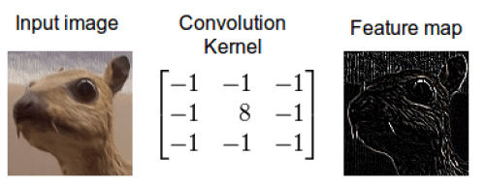
CNN concept
The Theory of Convolutional Layer
Different convolutional kernels can extract different types of spatial features.
The style as well as the size of the convolution kernel can be customized, with the most common being sizes of 3x3 and 5x5.
1 | 0 | 0
0 | 1 | 0
0 | 0 | 1
Convolutional kernel that extracts the “lower right line feature”.
0 | 0 | 1
0 | 1 | 0
1 | 0 | 0
Convolutional kernel that extracts “contour feature”.
Convolutional kernel that extracts the “upper right line feature”.

Slide 35
CNN concept
The Theory of Convolutional Layer
Input image
Convolution kernel
Feature map
0 | 0 | 0 | 0 | 0 | 0 | 0
0 | 1 | 0 | 0 | 0 | 1 | 0
0 | 0 | 1 | 0 | 1 | 0 | 0
0 | 0 | 0 | 1 | 0 | 0 | 0
0 | 0 | 1 | 0 | 1 | 0 | 0
0 | 1 | 0 | 0 | 0 | 1 | 0
0 | 0 | 0 | 0 | 0 | 0 | 0
2 | 0 | 1 | 0 | 1
0 | 3 | 0 | 1 | 0
1 | 0 | 3 | 0 | 1
0 | 1 | 0 | 3 | 0
1 | 0 | 1 | 0 | 2
1 | 0 | 0
0 | 1 | 0
0 | 0 | 1
*
=
7 x 7
3 x 3
5 x 5
$${height}_{out}= {height}_{in} − {kernel}_{height}+1$$
$${width}_{out}= {width}_{in} − {kernel}_{width}+1$$

Slide 36
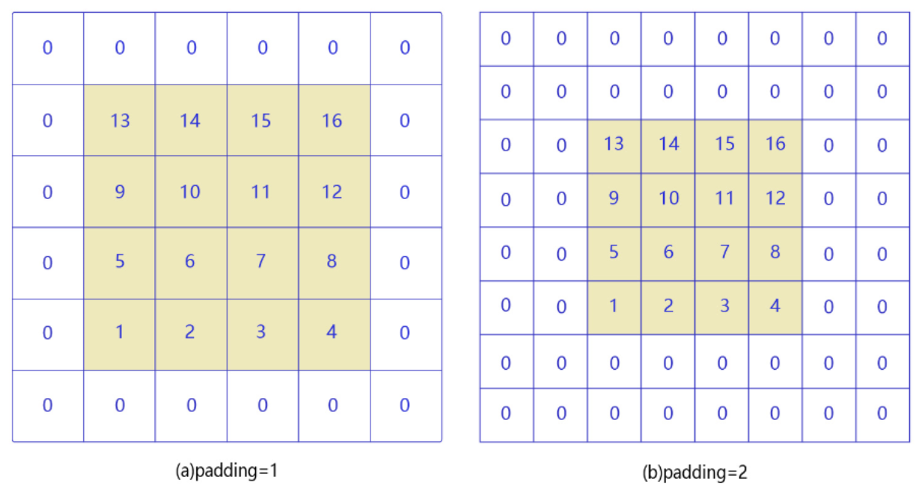
CNN concept
The Theory of Convolutional Layer
Padding
To avoid the size of the image becoming smaller after convolution, a filling operation is usually performed at the periphery of the image.
$${height}_{out}= {height}_{in} − {kernel}_{height}+1$$
$${width}_{out}= {width}_{in} − {kernel}_{width}+1$$
Convolution kernel=3x3, padding=1 layer, no change in image size after convolution.
Convolution kernel = 5x5, padding = 2 layers, no change in image size after convolution.

Slide 37
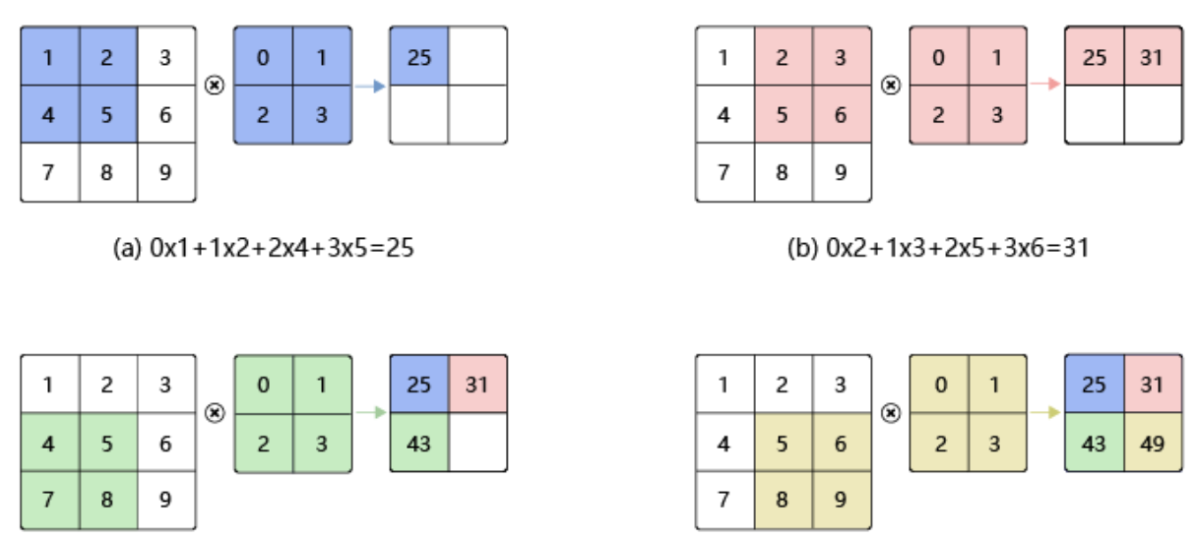
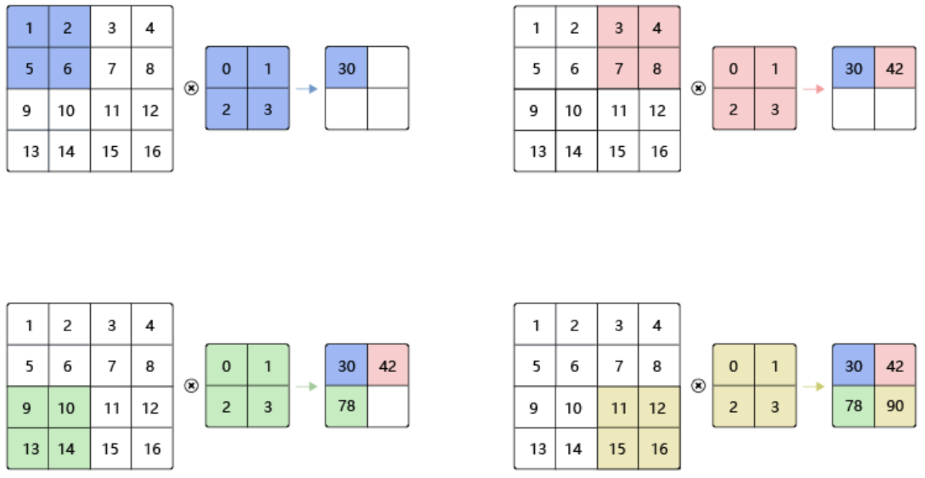
CNN concept
The Theory of Convolutional Layer
Stride
The stride control of the distance each time the convolution kernel slides also affects the size of the convolved image.
Stride = 1
Stride = 2

Slide 38
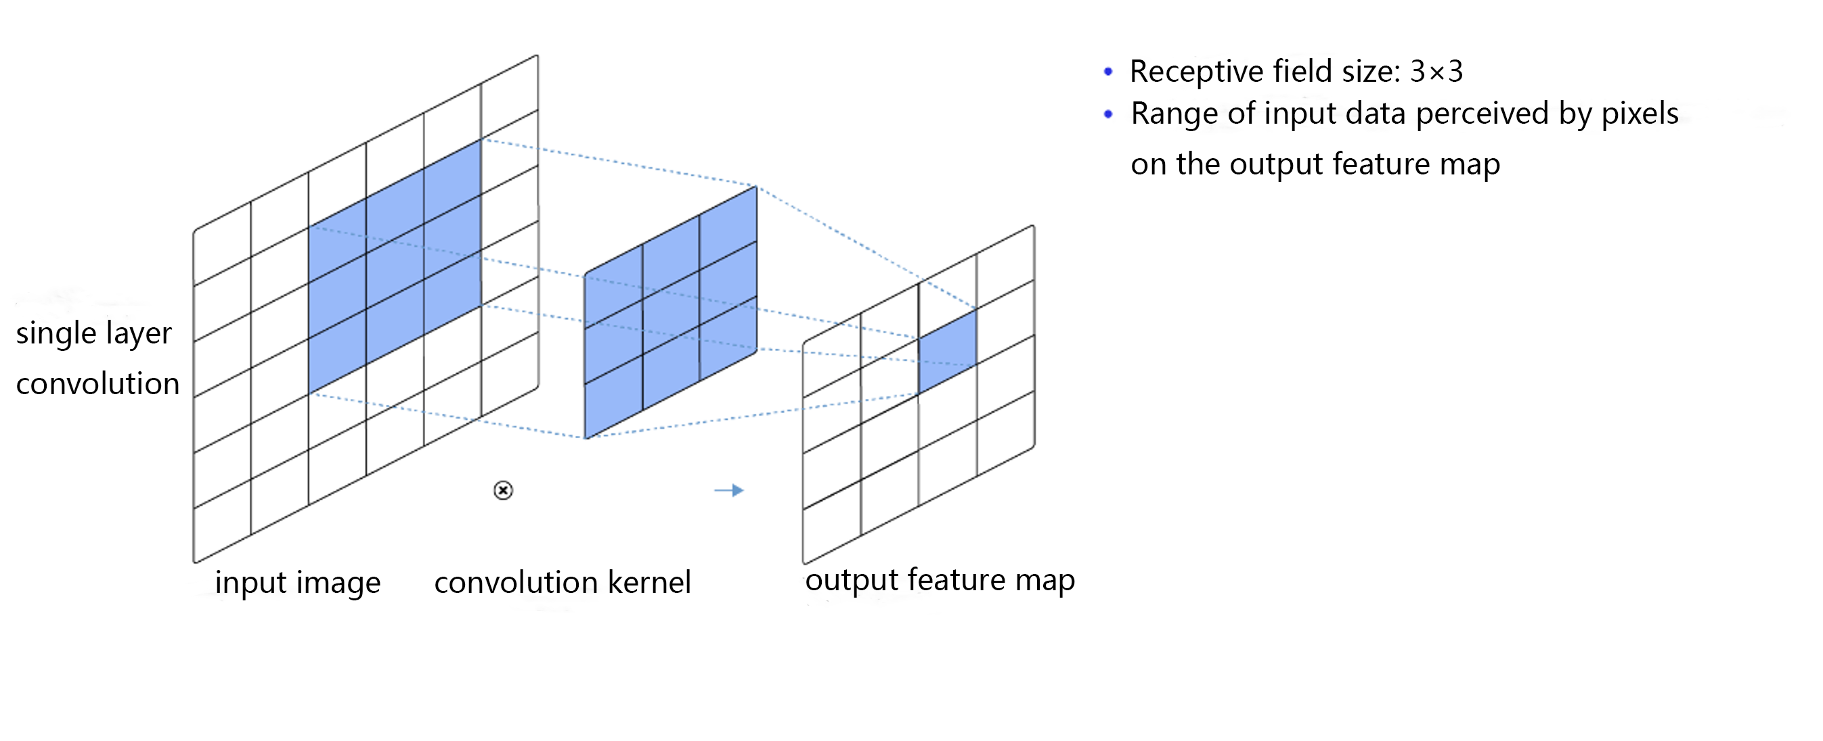
CNN concept
The Theory of Convolutional Layer
Receptive Field

Slide 39
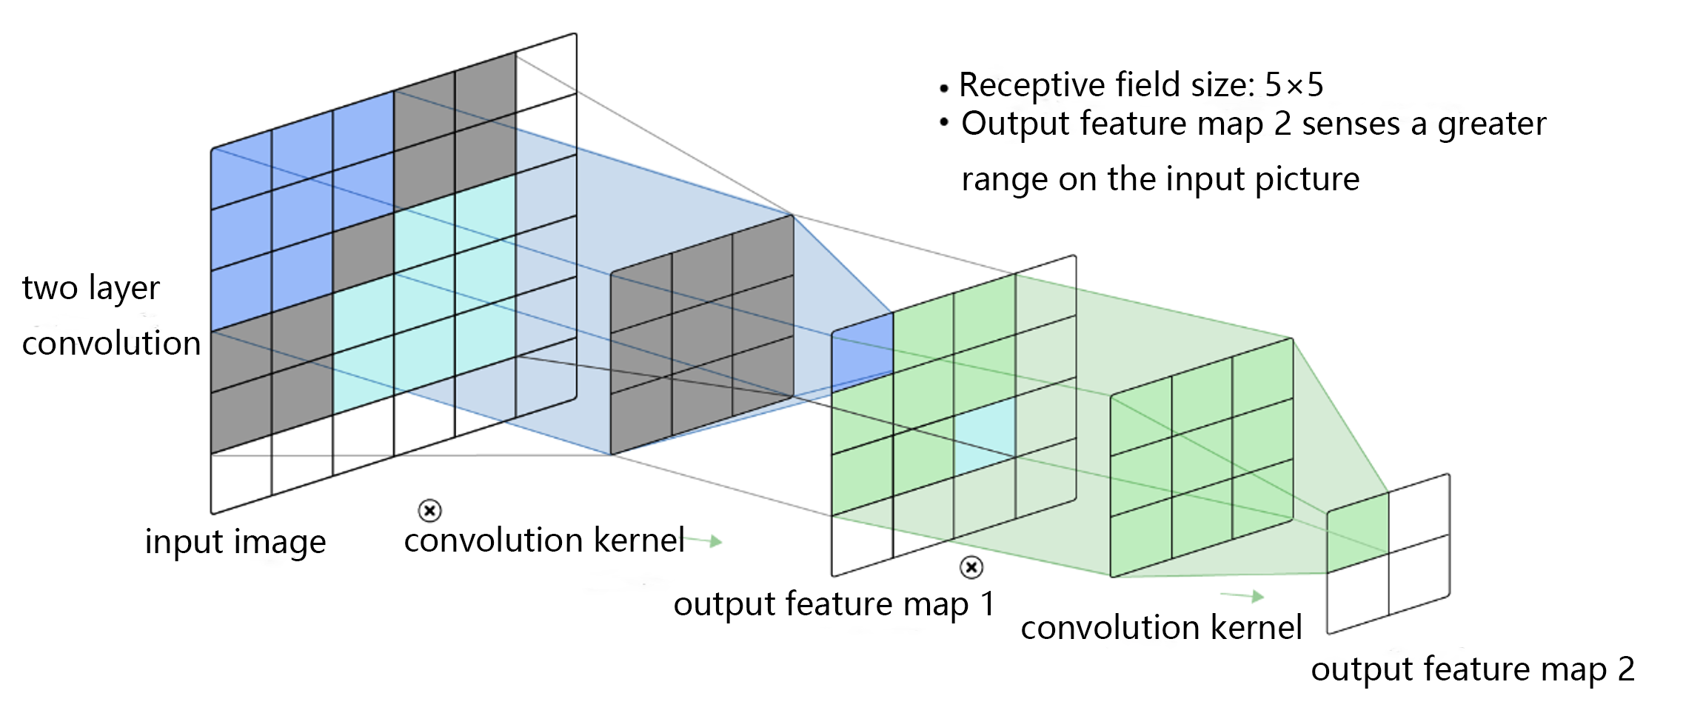
CNN concept
The Theory of Convolutional Layer
Receptive Field

Slide 40
CNN concept
The Theory of Convolutional Layer
1 | 2 | 3
4 | 5 | 6
7 | 8 | 9
Multi-channel input
0 | 1
2 | 3
25
+
1 | 2 | 21
4 | 5 | 24
7 | 8 | 27
1 | 2 | 12
4 | 5 | 15
7 | 8 | 18
1 | 2 | 12
4 | 5 | 15
7 | 8 | 18
4 | 5
6 | 7
1101
1 | 2 | 3
4 | 5 | 6
7 | 8 | 9
0 | 1
2 | 3
271
+
Final output results
Output dimension [2,2]
[H_{out}, W_{out}]
10 | 20 | 21
22 | 23 | 24
25 | 26 | 27
8 | 9
10 | 11
805
The number of input channels is 3
Input dimension [3,3,3]
[C_{in}, H_{in}, W_{in}]
The number of input channels is 3
Input dimension [3,2,2]
[C_{in}, k_{h}, k_{w}]
Calculate separately for each input channel, and sum up the output results of each channel.

Slide 41
CNN concept
The Theory of Convolutional Layer
Multi-channel output
Stack results from different output channels together
Output dimensions [2,2,2]
[C_{out}, H_{out}, W_{out}]
The number of input channels is 3
Input dimension [3,3,3]
[C_{in}, H_{in}, W_{in}]
Convolutional kernel output channel number is 2
Convolution kernel dimension [2,3,2,2]
[C_{out}, C_{in}, k_{h}, k_{w}]
Separate convolution operation for each output channel

Slide 42
CNN concept
The Theory of Convolutional Layer
Batch processing of multiple images
Output feature map 1
image1
Stack results from different images together
Output the dimension [2,2,2,2]
Convolutional kernel output channel number is 2
Convolution kernel dimension [2,3,2,2]
[C_{out}, C_{in}, k_{h}, k_{w}]
Output feature map 2
Input 2 images
Input dimensions [2,3,3,3]
[N, C_{in}, H_{in}, W_{in}]
image2
[N, C_{out}, H_{out}, W_{out}]
Convolution is performed separately for each image

Slide 43
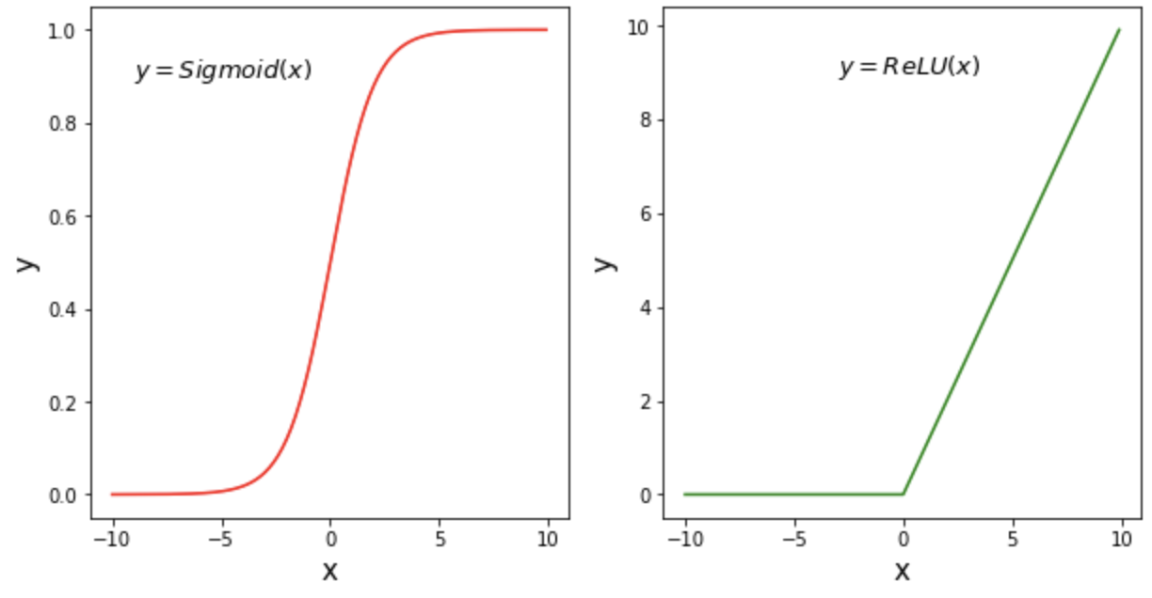
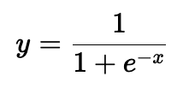
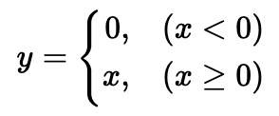
CNN concept
The Theory of Convolutional Layer
After outputting the feature map through the convolutional layer, an activation function is often used to introduce nonlinear elements to it.
Activation function
Convolutional layer
Pooling layer
Fully connected layer

Slide 44
CNN concept
The Theory of Pooling Layer
Convolutional layer
Pooling layer
Fully connected layer
Input layer
The pooling layer compresses the size of the image by downsampling, reducing the amount of parameter computation of the neural network.
Input
Convolutional layer
Pooling layer

Slide 45
CNN concept
The Theory of Pooling Layer
feature map
feature map after pooling
2 | 0 | 1 | 0 | 1 | 1
0 | 3 | 0 | 1 | 0 | 0
1 | 0 | 3 | 0 | 1 | 0
0 | 1 | 0 | 3 | 0 | 1
1 | 0 | 1 | 0 | 3 | 1
0 | 0 | 1 | 1 | 2 | 2
Pooling window
3
Pooling method: Maximum value in the selected area

Slide 46
CNN concept
The Theory of Pooling Layer
feature map
feature map after pooling
2 | 0 | 1 | 0 | 1 | 1
0 | 3 | 0 | 1 | 0 | 0
1 | 0 | 3 | 0 | 1 | 0
0 | 1 | 0 | 3 | 0 | 1
1 | 0 | 1 | 0 | 3 | 1
0 | 0 | 1 | 1 | 2 | 2
Pooling method: Maximum value in the selected area
3 | 1

Slide 47
CNN concept
The Theory of Pooling Layer
feature map
feature map after pooling
2 | 0 | 1 | 0 | 1 | 1
0 | 3 | 0 | 1 | 0 | 0
1 | 0 | 3 | 0 | 1 | 0
0 | 1 | 0 | 3 | 0 | 1
1 | 0 | 1 | 0 | 3 | 1
0 | 0 | 1 | 1 | 2 | 2
Pooling method: Maximum value in the selected area
3 | 1 | 1

Slide 48
CNN concept
The Theory of Pooling Layer
feature map
feature map after pooling
2 | 0 | 1 | 0 | 1 | 1
0 | 3 | 0 | 1 | 0 | 0
1 | 0 | 3 | 0 | 1 | 0
0 | 1 | 0 | 3 | 0 | 1
1 | 0 | 1 | 0 | 3 | 1
0 | 0 | 1 | 1 | 2 | 2
3 | 1 | 1
1
Pooling method: Maximum value in the selected area

Slide 49
CNN concept
The Theory of Pooling Layer
feature map
feature map after pooling
2 | 0 | 1 | 0 | 1 | 1
0 | 3 | 0 | 1 | 0 | 0
1 | 0 | 3 | 0 | 1 | 0
0 | 1 | 0 | 3 | 0 | 1
1 | 0 | 1 | 0 | 3 | 1
0 | 0 | 1 | 1 | 2 | 2
Pooling method: Maximum value in the selected area
3 | 1 | 1
1 | 3 | 1
1 | 1 | 3

Slide 50
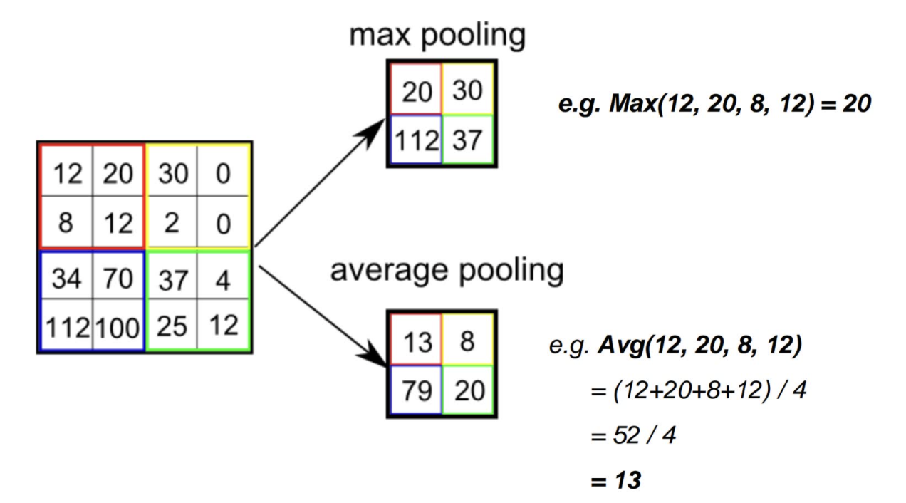
CNN concept
The Theory of Pooling Layer
The method of pooling
Max Pooling
Average Pooling
Feature Map

Slide 51
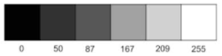
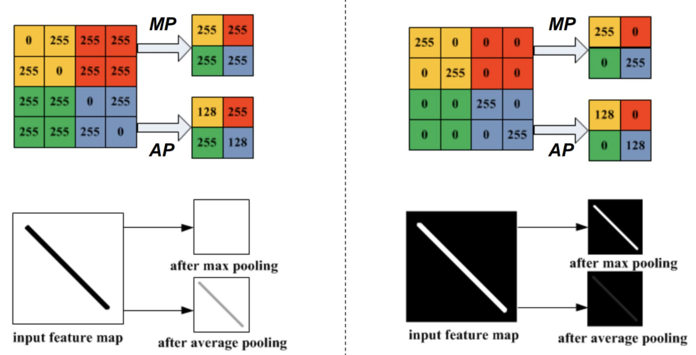
CNN concept
The Theory of Pooling Layer
Which pooling method is better?
Max Pooling (MP) Defect
Average Pooling (AP) Defect

Slide 52
CNN concept
The Theory of Pooling Layer
x N Perform multiple feature extraction
Convolutional layer
Pooling layer
Fully connected layer
Input layer
Input
Convolutional layer
Pooling layer
Fully connected layer

Slide 53
CNN concept
The Theory of Pooling Layer
Convolutional layer
Pooling layer
Convolutional layer
Pooling layer
……
Fully connected layer
Input layer
Input
Convolutional layer
Pooling layer
Fully connected layer

Slide 54
CNN concept
The Theory of Fully Connected Layer
Flatten layer
Convolutional layer
Pooling layer
Fully connected layer
Input layer
Flatten Layer
Input
Convolutional layer+ Pooling layer
Fully connected layer

Slide 55
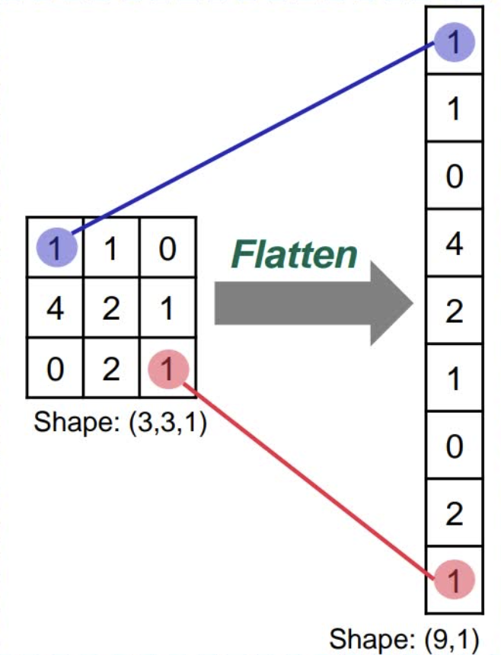
CNN concept
The Theory of Fully Connected Layer
Flatten Layer
Flatten Layer

Slide 56
CNN concept
The Theory of Fully Connected Layer
Fully Connected Layer
（0.72）
（0.28）

Slide 57
CNN concept
Summary of CNN Structure
Sigmoid
Relu
Activation function
Activation function
Flatten layer
Convolutional layer
Pooling layer
Convolutional layer
Pooling layer
……
Fully connected layer
Input layer
Kernel
Padding
Stride
Receptive Field
Max Pooling
Average Pooling

Slide 58
CNN concept
The training process of CNN
The inputs are operated with the weight matrix and the activation function, and the output of the previous layer is used as the input of the next layer until the result is output.
Forward propagation
The error between the predicted and true values of the model is calculated based on the loss function.
Calculation of losses
Based on the current loss, the parameters are updated in reverse order based on the chain rule.
Backward propagation
Based on the gradient descent algorithm, the parameters are updated according to the learning rate and gradient.
Updating parameters

Slide 59
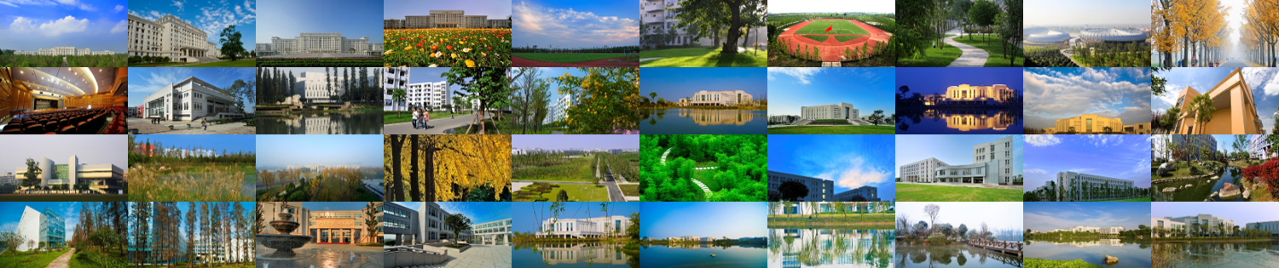
Thanks to Baidu PaddlePaddle Materials ！
Thanks！

